Slide 1
Lecture 13 - Basic Information Theory
DS 4400: Machine Learning and Data Mining 1

Slide 2
Today
1 Today
Information Theory
Entropy
Cross Entropy
KL Divergence
Mutual Information

Slide 3

















From PDFs, CDFs, and sampling, to VAES

Slide 4

Information Theory
Information theory, pioneered by Claude Shannon, quantifies information based on probability.
The key idea is:
Highly probable events contain little information because they are expected.
Unlikely events contain a lot of information because they are surprising.

Slide 5
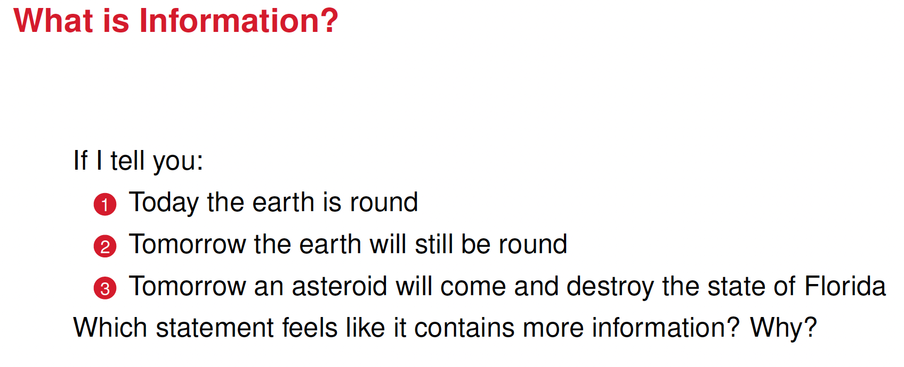

Slide 6
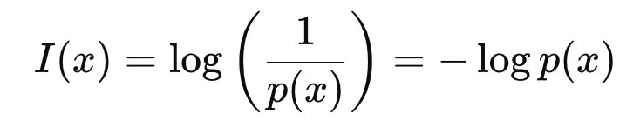
Self-Information (Surprisal)
The formula
quantifies how "surprising" an event x is.
High probability events p(x) ≈ 1 → low information content (they are expected).
Low probability events p(x) ≈ 0 → high information content (they are surprising).
Example
If you hear "the sun will rise tomorrow," you don’t gain new knowledge.
If you hear "aliens landed on Earth," it's unexpected and highly informative.

Slide 7
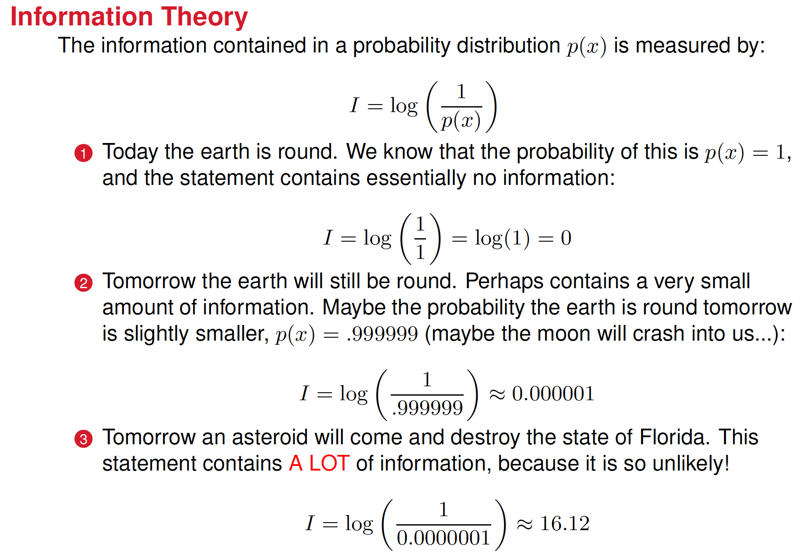

Slide 8
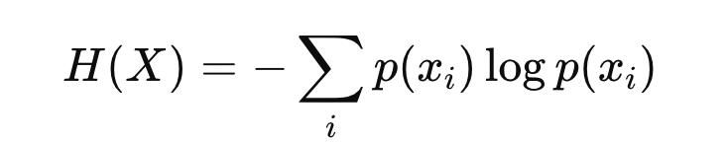
Entropy: The Average Information Content
Self-information tells us how much information a single event carries, entropy measures the average amount of information in a probability distribution. Entropy, H(X), is given by
where X is a random variable with different possible outcomes x_{i}
Properties
Low Entropy: When one outcome is highly probable while others are rare, entropy is low because uncertainty is minimal (e.g., a biased coin that lands on heads 99% of the time).
High Entropy: When all outcomes are equally likely (e.g., a fair coin flip or rolling a fair die), entropy is maximized because there's more uncertainty.
Zero Entropy: If one outcome is 100% probable while the rest have zero probability of occurring, entropy is zero because there’s no new information.

Slide 9
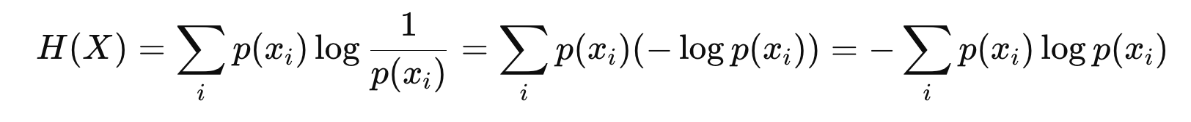
Entropy is the Expected Value of Self-Information (expected information of a probability distribution)
Entropy measures the average amount of information (or uncertainty) in the probability distribution
Interpretation of entropy
Entropy tells us the unpredictability of a system.
It is crucial in data compression, AI, machine learning, and cryptography.

Slide 10
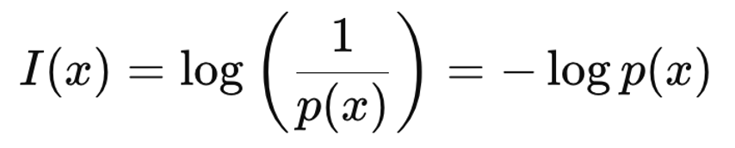
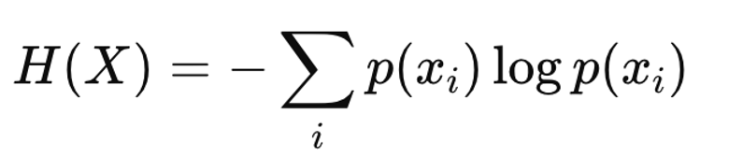
Summary
Self-information quantifies how surprising an event is.
Entropy measures the average uncertainty in a system.

Slide 11
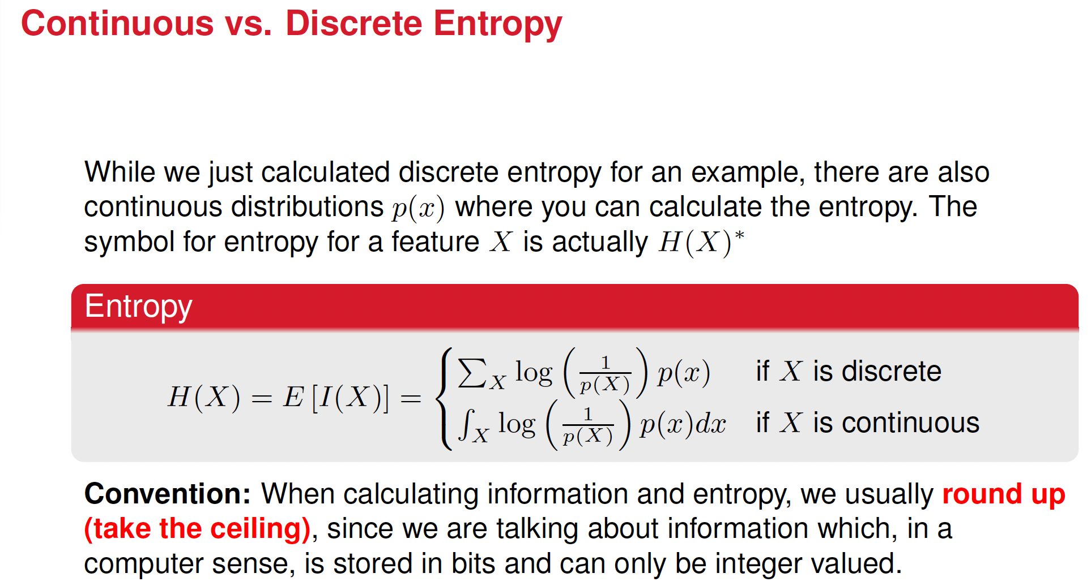

Slide 12
The choice of logarithm base in entropy calculations depends on the context and interpretation of the units of entropy
Binary outcomes (e.g., coin flips, yes/no questions, binary classification in machine learning): use log base 2 (log₂) because it measures entropy in bits
General outcomes (e.g., multiple categories, probability distributions over many states…): Use base e (ln, natural log), which measures entropy in nats (natural information units).

Slide 13
Calculate the Entropy for these two cases:
Fair coin (all outcomes are equally probably and = 0.5)
Biased coin (90% head, 10% tail)

Slide 14












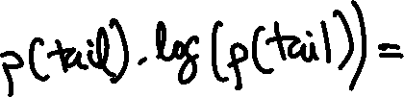




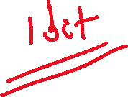






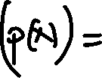

Slide 15


























Slide 16
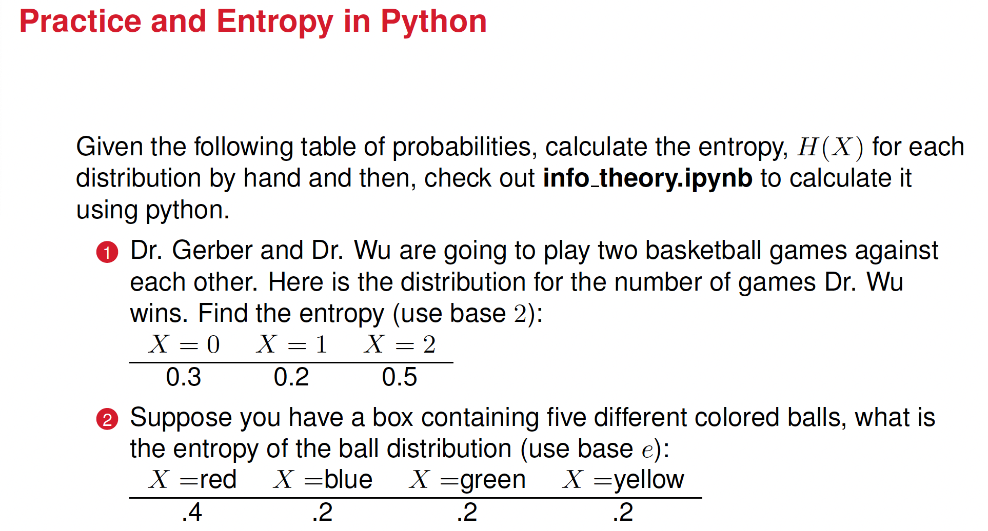

Slide 17
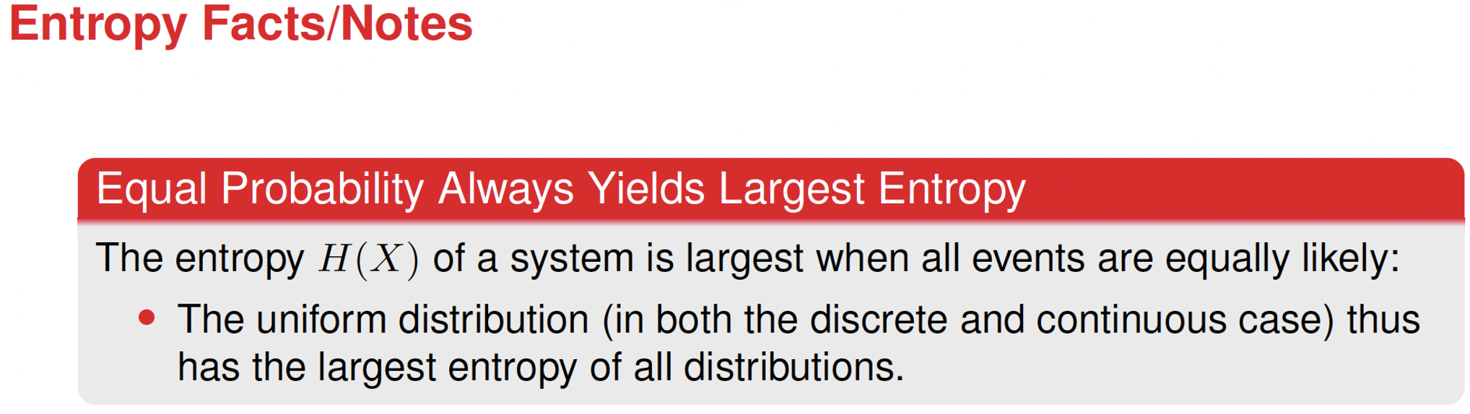

Slide 18
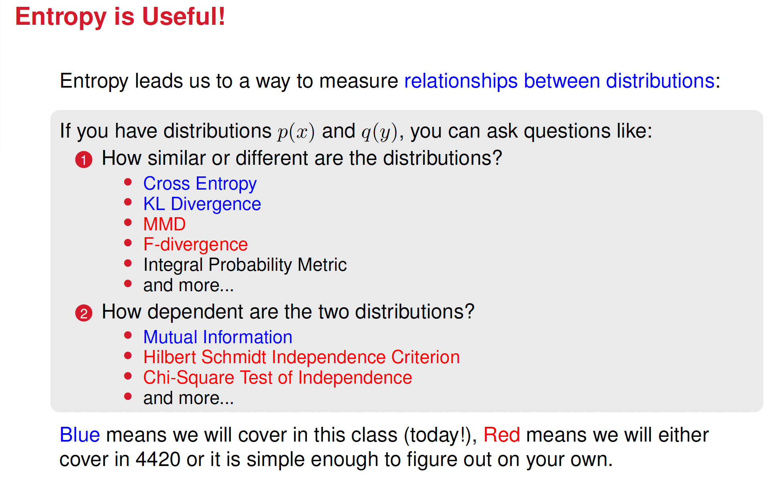

Slide 19
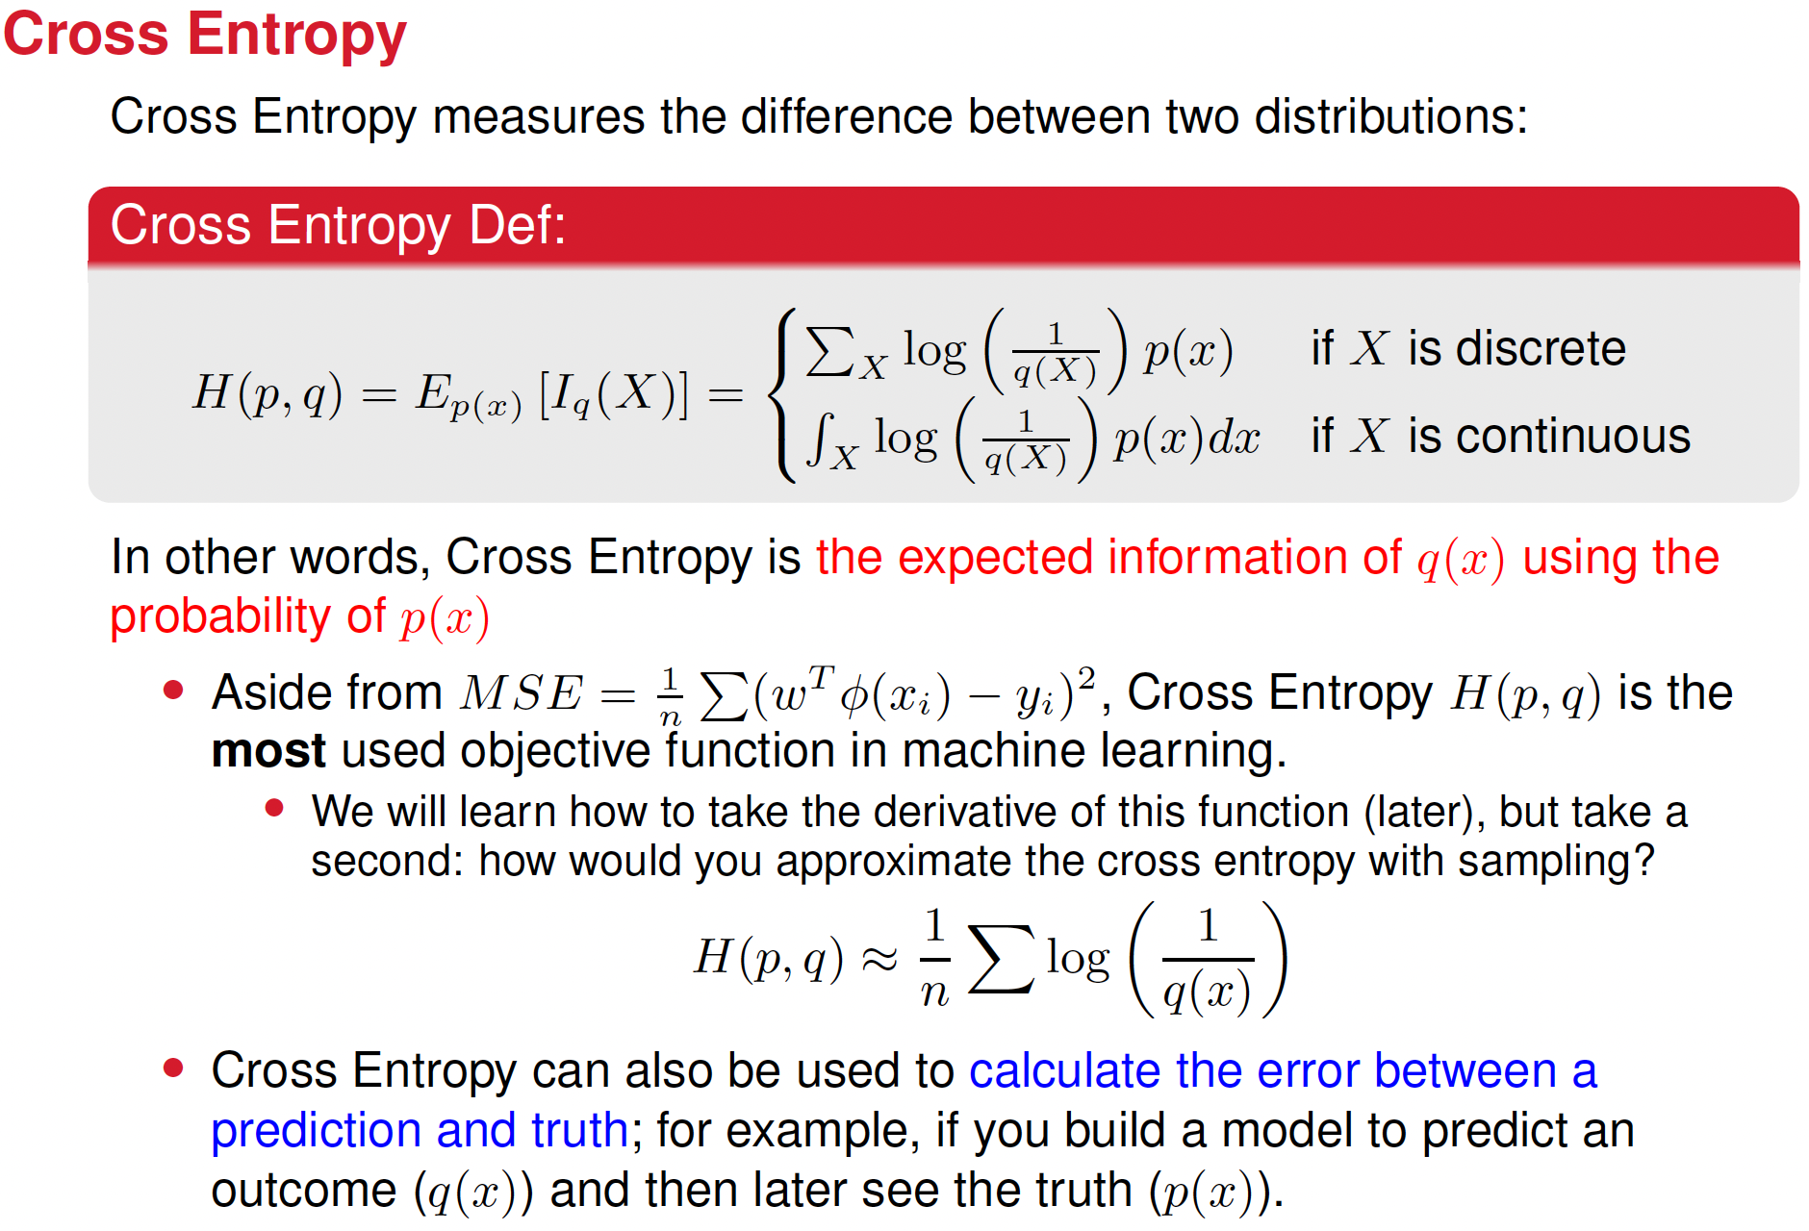

Slide 20
What is Cross Entropy (in simple terms)?
Cross entropy measures how well one probability distribution matches or approximates another.
Imagine you have:
A "true" probability distribution, representing the reality (what’s really happening).
An "estimated" distribution, representing your predictions or guesses.
Cross entropy calculates how different your predictions are from the reality
Lower cross entropy means your predictions are closer to reality
Higher cross entropy means your predictions are further off.

Slide 21
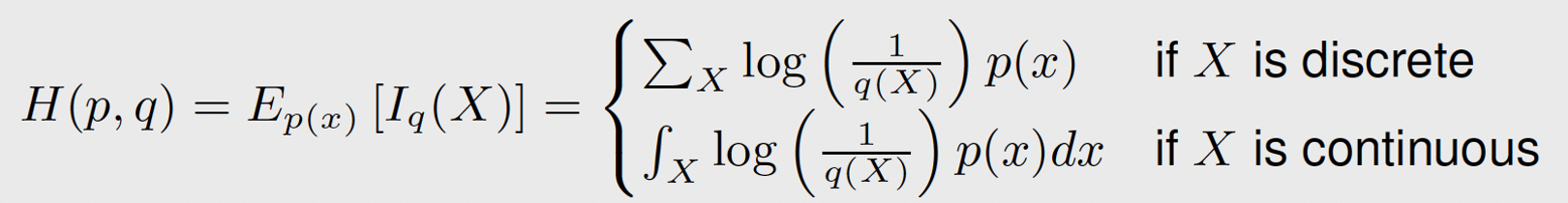

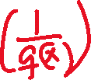
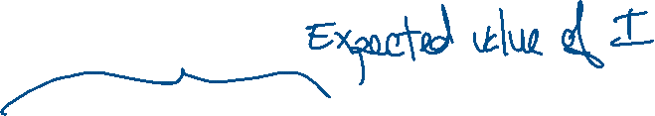
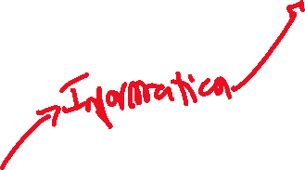
Cross entropy
If the true distribution is p(x), and the estimated distribution is q(x), cross entropy is defined as:
This formula calculates an average score: it uses the true probabilities to weigh how "wrong" the predictions are.
When q(x) matches p(x) closely, cross entropy is low.
When q(x) differs a lot from p(x) cross entropy is high.

Slide 22
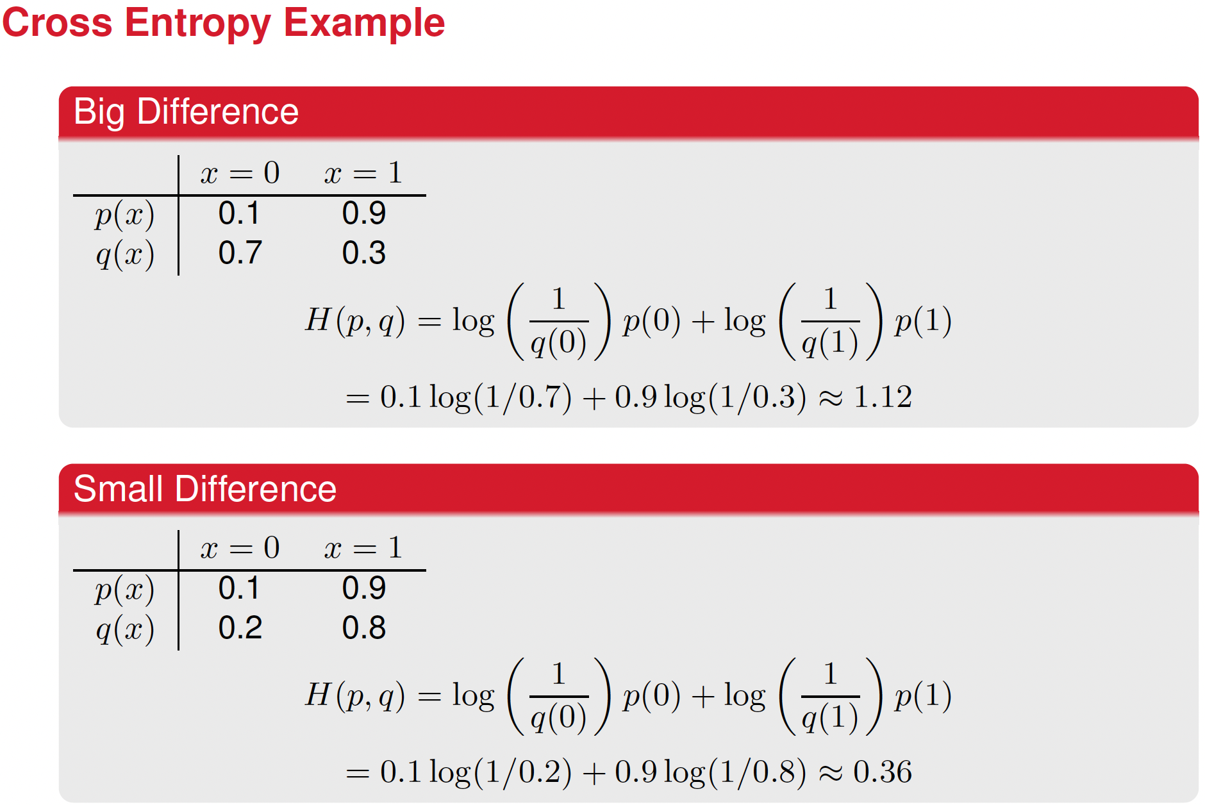

Slide 23
Why is Cross Entropy Useful?
Cross entropy provides a clear way to measure how good predictions are. For this reason, cross entropy is used as a cost function (as the MSE in regression)
In machine learning, particularly neural networks:
Training a model means adjusting predictions q(x) so they match reality p(x) better.
The goal is to minimize cross entropy—smaller cross entropy means better predictions.

Slide 24


























Difference Between Entropy and Cross Entropy
Entropy H(p): measures uncertainty or information content within a single distribution.
Cross Entropy H(p,q): measures how close two different distributions are, usually reality vs. prediction.
If q(x)=p(x) exactly, cross entropy equals entropy (best possible prediction):
Otherwise, cross entropy is always greater than entropy:
The difference H(p,q) - H(p) called Kullback-Leibler (KL) divergence

Slide 25
Cross-entropy summary, in simple terms:
Cross entropy measures the "distance" or "difference" between what is true and what you predict.
Lower cross entropy → better prediction.
Used widely to train machine learning models to become more accurate.

Slide 26
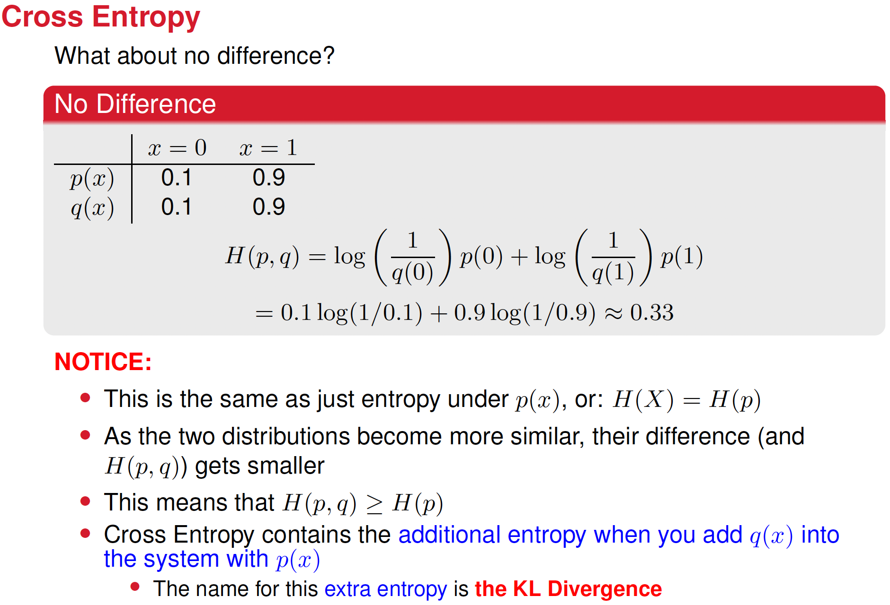

Slide 27
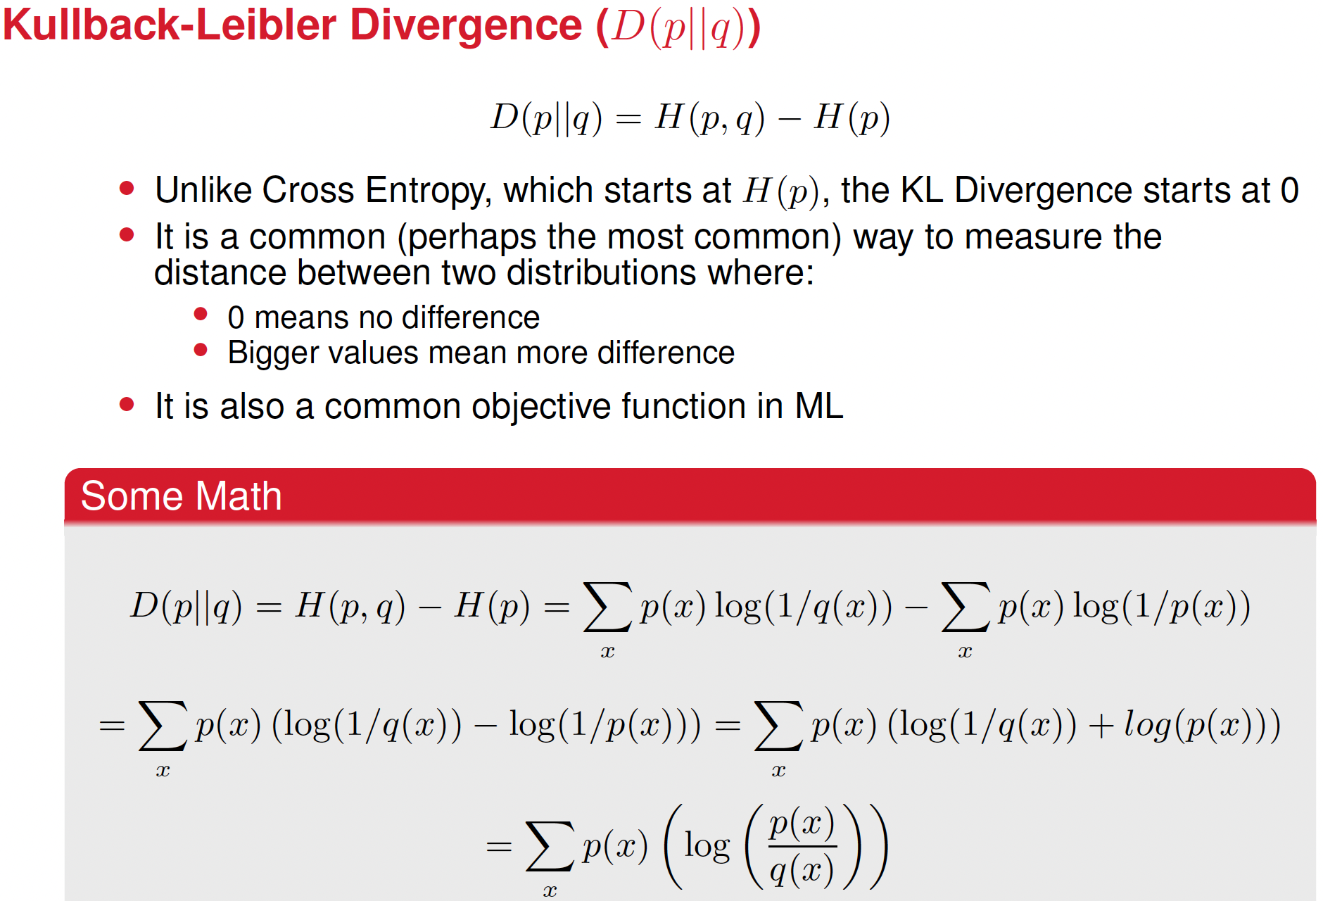

Slide 28
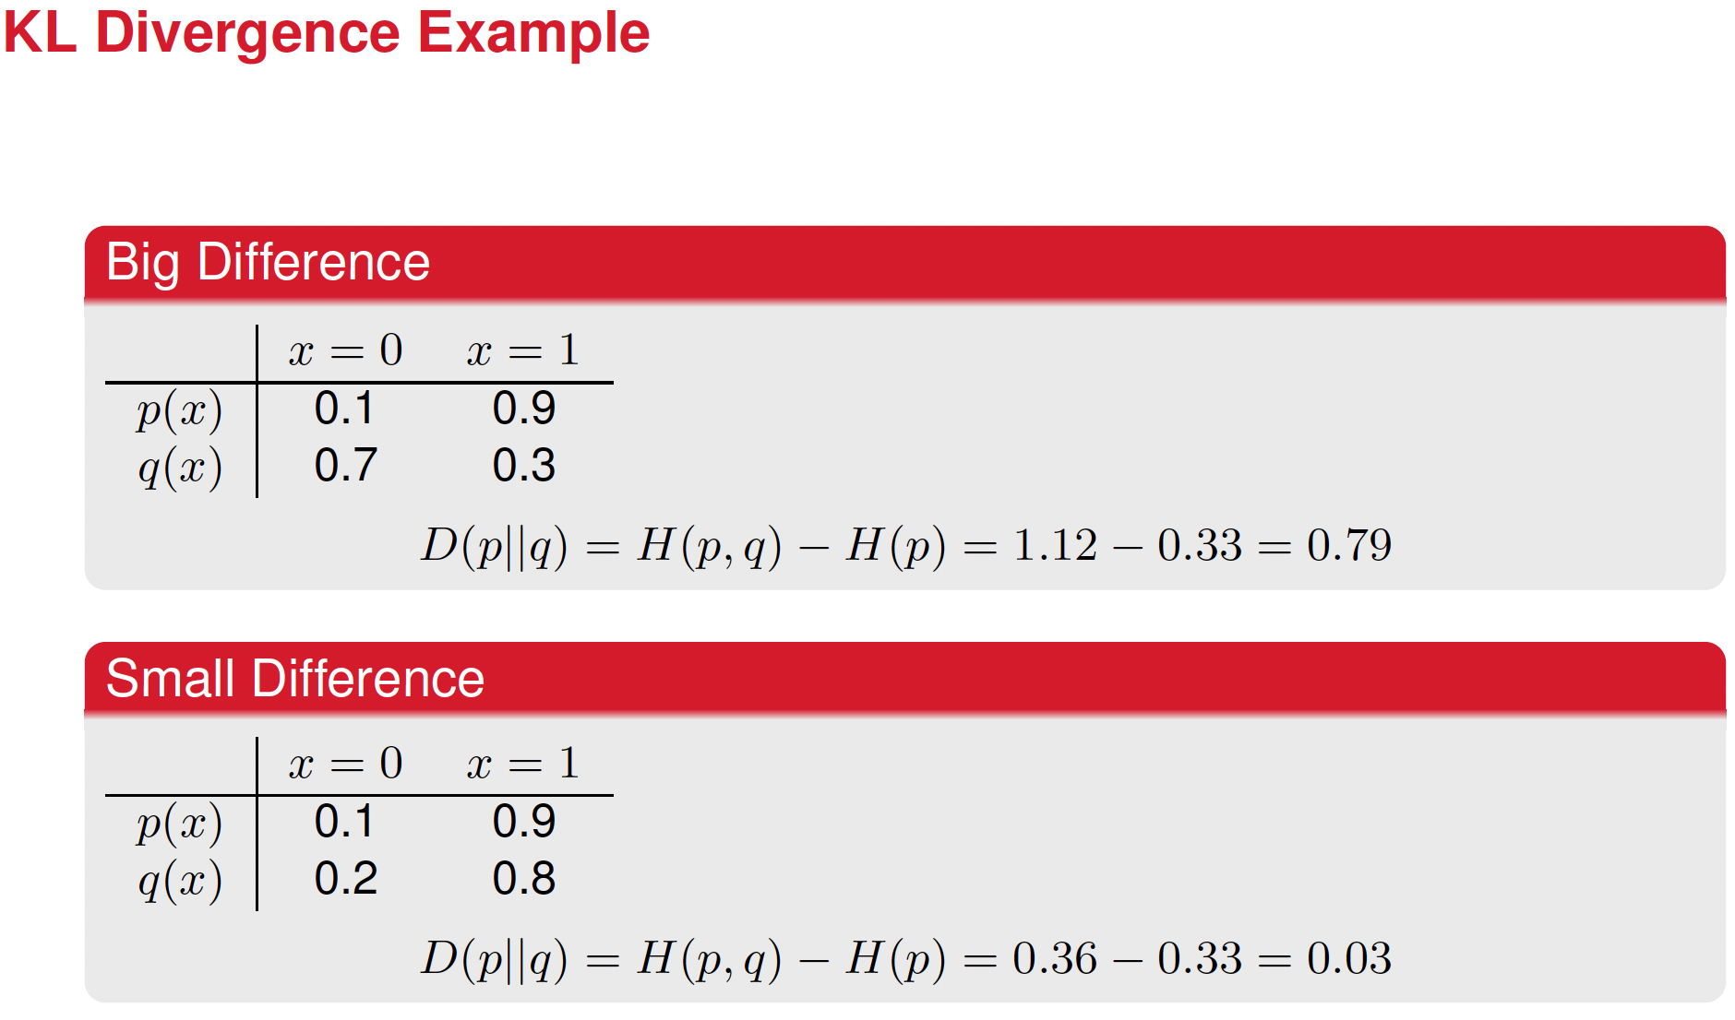

Slide 29
Entropy, Cross Entropy and KL Divergence in the context of data compression
Entropy H(p): the optimal number of bits per symbol if we knew the true distribution p(x) (Shannon’s Source Coding Theorem). Tells us the minimum bits per symbol on average when encoding data perfectly.
Cross Entropy H(p,q): the actual number of bits per symbol if we mistakenly encode using q(x) instead of p(x). Tells us the average bits per symbol we need when encoding data, assuming we use q(x) instead of p(x)
KL Divergence: Measures only the extra bits wasted due to using q(x) instead of p(x)
If DKL = 0 D , q(x) = p(x), we’re encoding optimally
If DKL >0 then we're wasting bits due to using the wrong distribution.

Slide 30
Entropy, Cross Entropy and KL Divergence in image comparison
Entropy H(p): How much natural variation exists in real images.
Cross Entropy H(p,q): How well a generated image distribution matches real images.
KL Divergence: How much information is lost when approximating real images with generated ones.

Slide 31
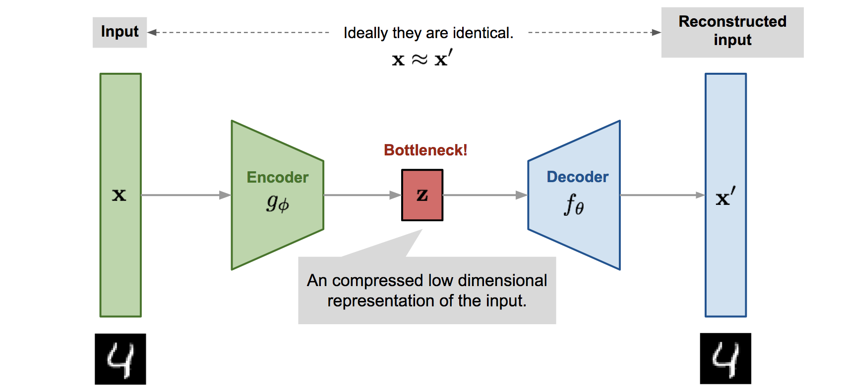
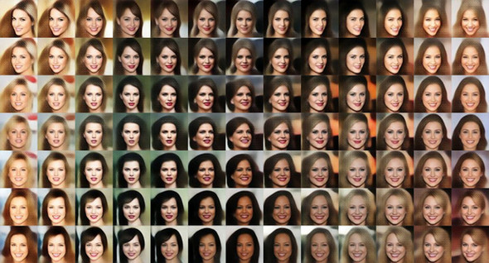
A Variational Autoencoder (VAE): a generative network

Slide 32
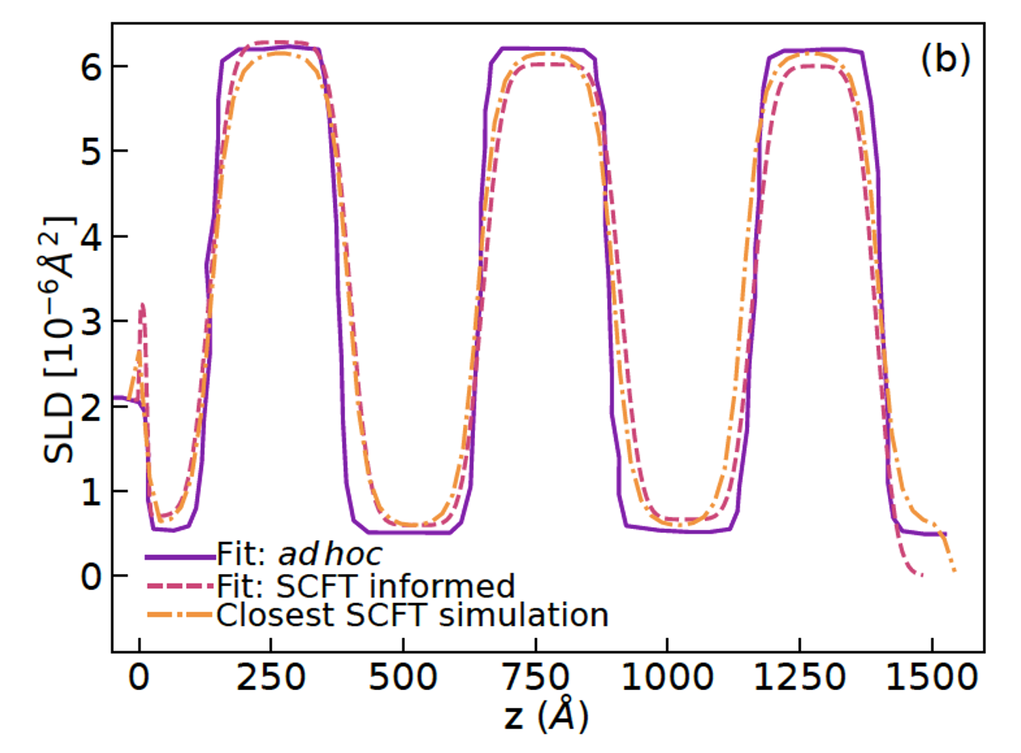
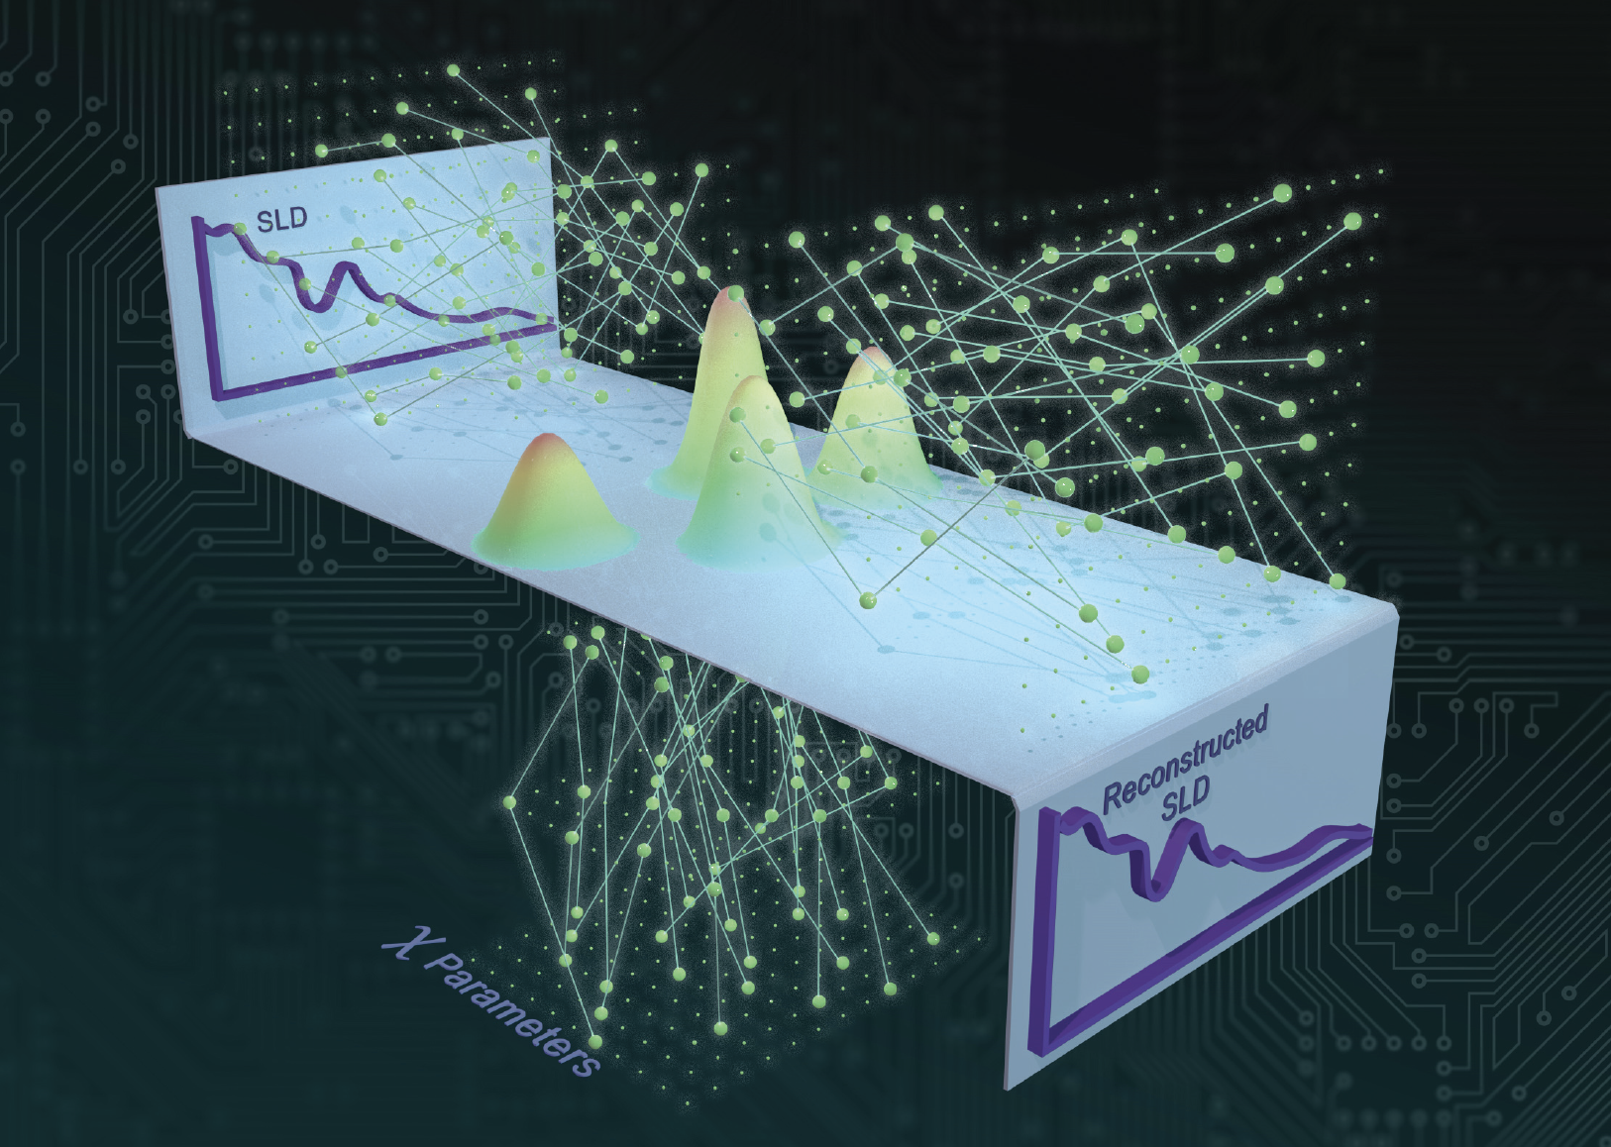
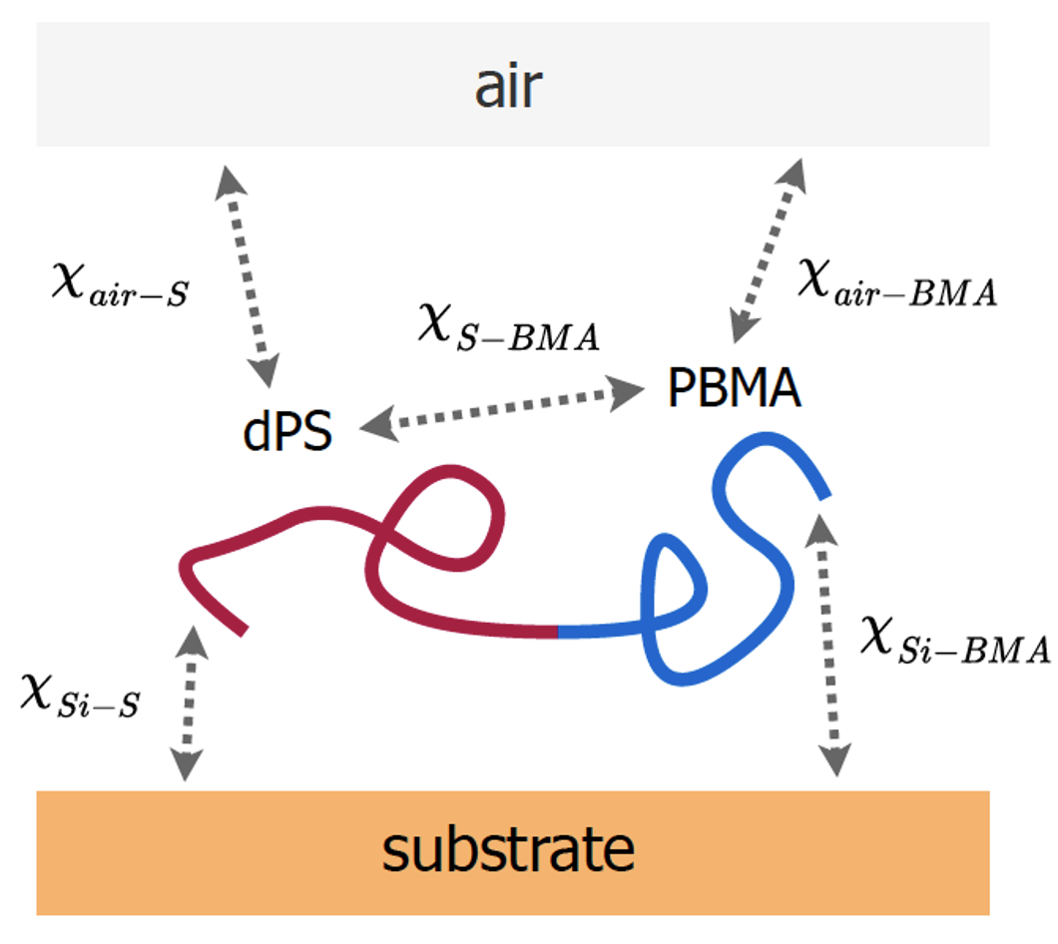
A Variational Autoencoder (VAE)
Eby et al., Nanoscale 15, 7280 (2023).

Slide 33

A Variational Autoencoder (VAE)
A VAE is a generative model that learns to encode images into a lower-dimensional latent space and then reconstruct or generate new images from this space.
The encoder learns a probabilistic mapping from input images to a latent representation, q(z|x)
The decoder learns to reconstruct images from this latent space.
VAEs enforce structure in the latent space using KL divergence with a Normal distribution (p(z))

Slide 34















KL Divergence in the VAE Loss Function
In VAEs, the loss function consists of two terms:
Reconstruction Loss (Cross Entropy)
This term ensures that the decoder reconstructs the input image correctly.
KL Divergence Term (Regularization)
Why KL Divergence in VAEs?
Regularization: It forces the latent space to follow a smooth and continuous distribution, preventing overfitting.
Generative Properties: If latent variables follow a normal distribution, we can easily sample new points and generate new images.
Interpolations & Meaningful Representations: A structured latent space allows for smooth interpolations between images.

Slide 35
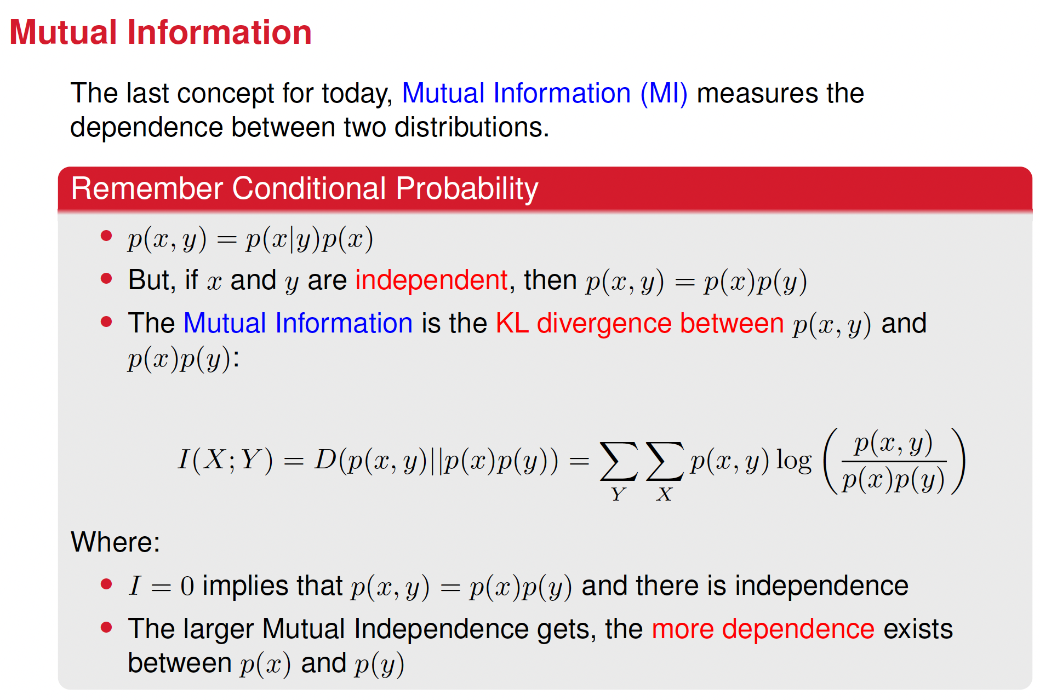

Slide 36
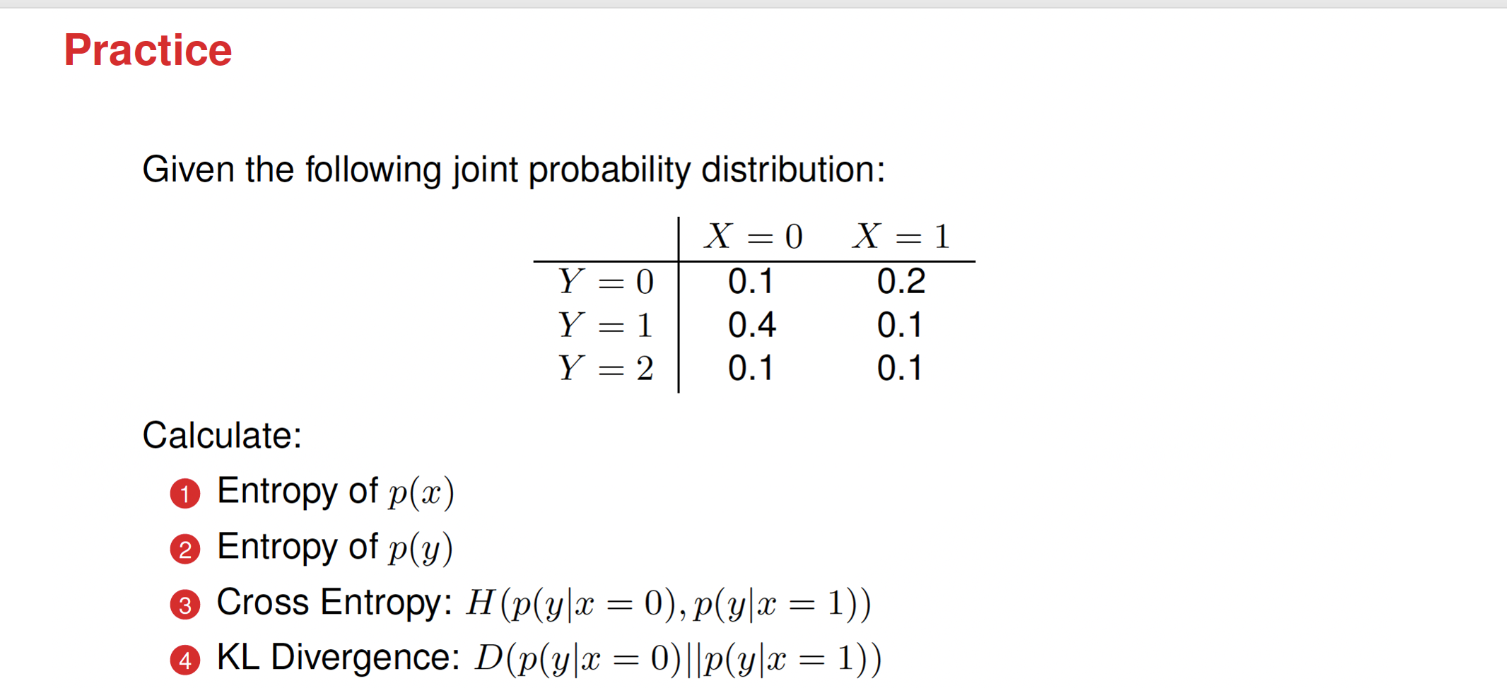

Slide 37
